Slide 1
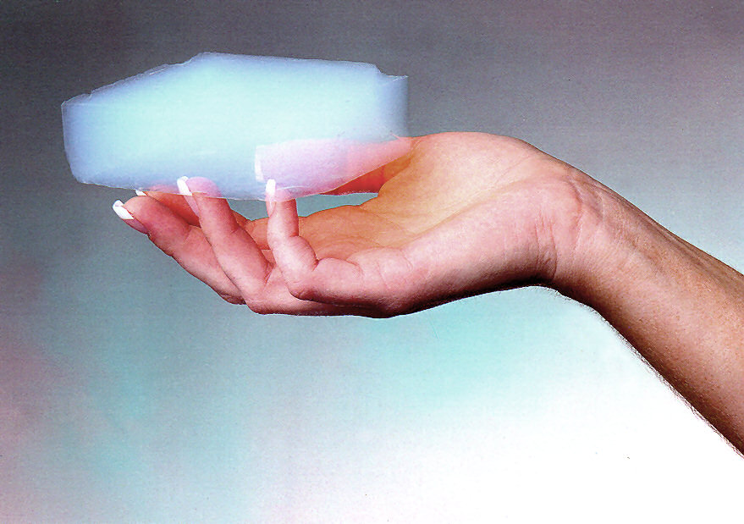

Study of optical properties of aerogel
Indra Sapkota

Slide 2
Outline of the study
Refractive index
Transmittance
Absorption length and scattering length
Outlook
Acknowledgement
2/14

Slide 3
Refractive Index
SHMS Detector is a threshold detector which needs several refractive indices to cover full range of particle momentum
  SHMS aerogel detector uses 4 indices
Threshold momentum is function of refractive index i.e. p_{t} =m/√(n²-1), where n is refractive index and m is mass of particle
Uniformity in refractive index is equally important for the threshold momentum since large number of aerogel tiles were used for the detector construction
Momentum threshold for proton, pion and kaon
according to the aerogel refractive index.
3/14

Slide 4
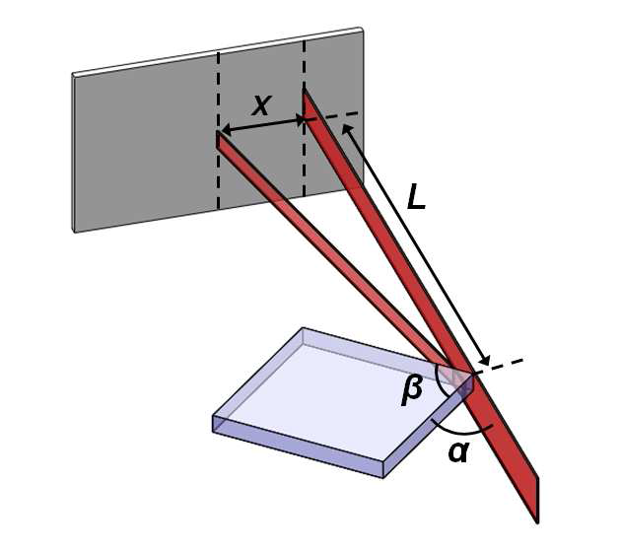
Refractive index measurement
Measurements of the refractive index of tiles were performed based on Snell’s law
Refraction of outgoing light is used to calculate refractive index
Tiles Refractive index
sp30 1.0303 ± 0.0007
sp20 1.0198 ± 0.0009
sp15 1.0152 ± 0.0004
sp11 1.0111 ± 0.0003
2.Schematic of the setup used
to measure the refractive index
of aerogel tiles.
1.Aerogel refractive index measured for a sample of
the tiles used on the construction of each tray. The refractive
index of aerogel was calculated using equation above assuming
nair= 1.000265.
3.Measurements of refractive index of aerogel tiles used
for the construction of the four trays of the detector
4/14

Slide 5
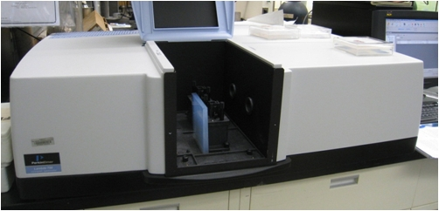
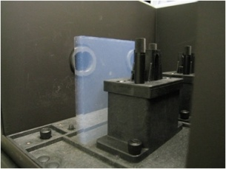
Transmittance Measurement
LAMBDA 750 UV/Vis/NIR
Spectrophotometer
In this spectrometer, a beam of light with tunable wavelength, is split into two beams
The first beam goes directly to the light sensor for the measurement of the reference light
While the second beam goes through one aerogel tile
Measurement done in the range of wavelength length from 200nm to 900nm
5/14

Slide 6
Results from Transmittance Measurement
SP-30 tiles have a higher transmittance than SP-20 tiles from the same company
The statistical fluctuation of light transmittance for the different tiles with the same refractive index is lower than 4%.
The systematic uncertainty of the measurements is ±0.1%.
Mean value of the light transmittance of aerogel measured
over a sample of 10 − 15% of the tiles used in the con-
struction of the detector
6/14

Slide 7
Scattering and absorption
Scattering, transmittance, and absorption occur simultaneously
They are related by equation, T(λ) = (1 − R(λ))exp(−t(1/L_{abs})− t(1/L_{scat})), Where t is thickness of aerogel tile. R is a reflectivity. These are the important parameter which determine light loss in detector
The scattering length in aerogel is determined by their
internal structure (pores) and goes as L_{scat} ∼ λ⁴ .
The absorption length is due to impurities and has an
order of magnitude L_{abs}∼ λ²
To disentangle the three contribution, we have to measure more than once
7/14

Slide 8
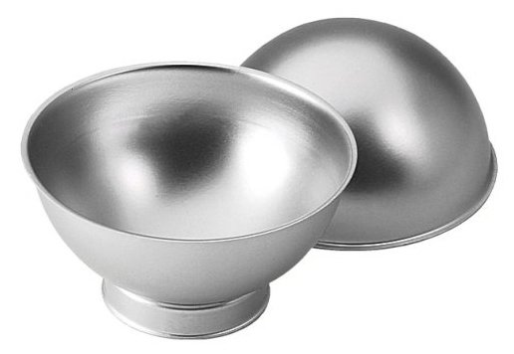
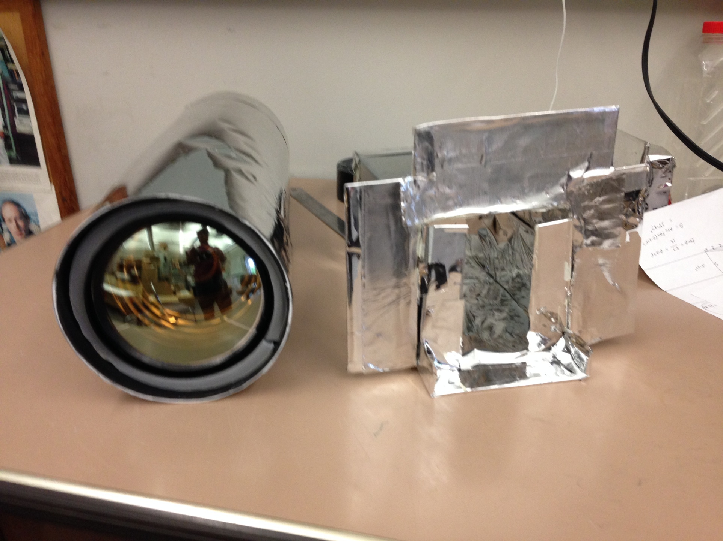
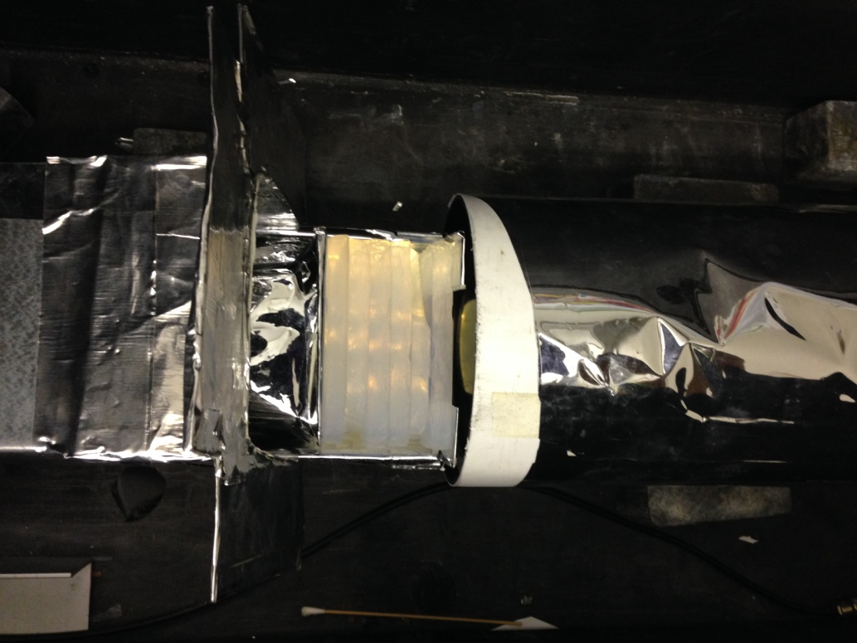
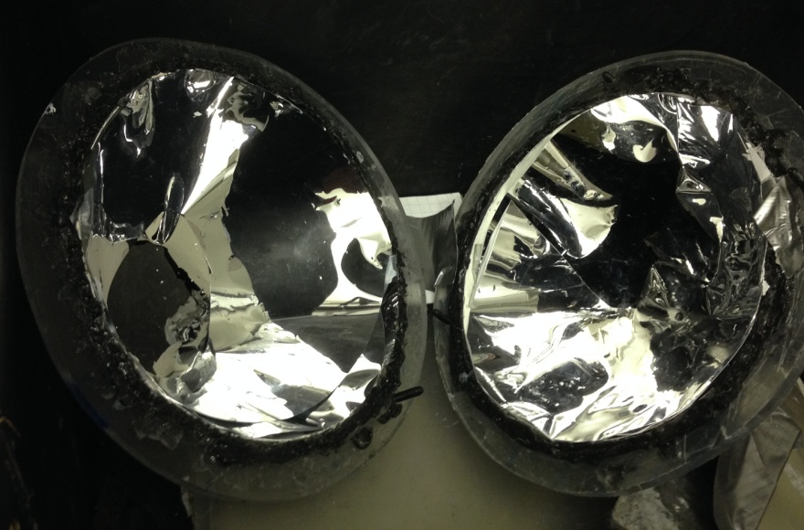
Experimental set up for determination of Absorption length
I have built Two set up to measure the absorption length.
  Integrating sphere, Rectangular aerogel holder
PMT
Set up 1
Set up 2
Dark box
Aerogel Tile holder
Integrating sphere
Collimator
8/14
Aerogel Tile

Slide 9
Absorption length measurement strategy (Using Set up 2)
The idea is to measure the light collection in the box with and without the aerogel.
Blue LED is used as light source.
5 inch PMT is used to collect light intensity.
The interface of PMT and LED is filled with aerogel tile.
Intensity of light recorded with aerogel (I), with out aerogel (I_{o}) at LED flashing and while at dark (I_{dark}) (no LED flashing).
Equation used to calculate absorption length.
I=Io exp (-x/λ_{abs} ) where I is number of photon count in presence of aerogel and Io is number of photon count with out aerogel. X is thickness of aerogel.
λ_{abs}= -x/ln(I/Io) in general λ_{abs}= - x/ln(I-I_{dark}/I_{o}-I_{dark})
9/14

Slide 10
Calculated Value of Abs. length in two different sets of Test
Test Tile | X ±0.034 cm (Thickness) | λ_{abs(cm)±0.78 in 1}^{st} test | λ_{abs(cm)±1.87} _{in 2}^{nd} test
1 | 1.1 | 7.3 | 12.22
2 | 2.2 | 10 | 12.9
3 | 3.3 | 10 | 12.6
4 | 4.4 | 9.3 | 11.2
5 | 5.5 | 8.7 | 10.1
6 | 6.6 | 9.3 | 9.29
7 | 7.7 | 9.7 | 8.85
8 | 8.8 | 9.5 | 8.6
9 | 9.9 | 9.7 | 8.25
10 | 11 | 10 | 7.91
11 | 12.1 | 9.5 | 7.85
12 | 13.2 | 9.42 | 7.85
1st Test : data were taken
In July 2014,
2nd Test : Data were taken after
repairing collimator to minimize size of beam spot on aerogel tile coming from LED.
10/14

Slide 11
Data Analysis
Data from the two measurements show different trends in the absorption length.
  Test1: abs. length deviates more at first tile but seems more consistent as number of tile increases
    Mean abs. length is 9.58 cm with SD ±0.7
  Test 2: Until 4 tiles, abs. length looks somewhat similar but afterwards decreases with increase of number tile.
    Mean abs. length is 9.36 cm with SD ±1.87
Since scattering and absorption takes place simultaneously, there may be an increase of scattering effect as number of tiles increased
11/14

Slide 12
Data Analysis
Quadratic fit to the log of the data
Based on literature abs. length should be independent of thickness and expected to be constant for particular wavelength.
We have measured at 400nm.
Comparison of the slopes of the best fit to the data and the literature value.
  Reciprocal of the slopes shown gives the absorption length. λ_{abs}= - x/ln(I-I_{dark}/I_{o}-I_{dark})
Slope of the fit function
Literature value
12/14

Slide 13
Out look
Instruments are going to be optimized. Reproducibility of data will be checked.
Further set of experiment is going to be done to investigate systematic error.
New approach to study absorption length using integrating sphere will be developed.
13/14

Slide 14
Acknowledgement
I like to thank HUGS organizer to provide me this great opportunity to enhance my knowledge and experience toward the research in Nuclear Physics.
Thank you !
14/14

